Slide 1
A country of immigrants? Settler colonialism, immigration, and race in the United States
Aviva Chomsky
New England Translators Association
April 28, 2018

Slide 2
A Settler Colonial Country: The Declaration of Independence
The history of the present King of Great Britain is a history of repeated injuries and usurpations, all having in direct object the establishment of an absolute Tyranny over these States. To prove this, let Facts be submitted to a candid world…
He has endeavoured to prevent the population of these States; for that purpose obstructing the Laws for Naturalization of Foreigners; refusing to pass others to encourage their migrations hither, and raising the conditions of new Appropriations of Lands…

Slide 3
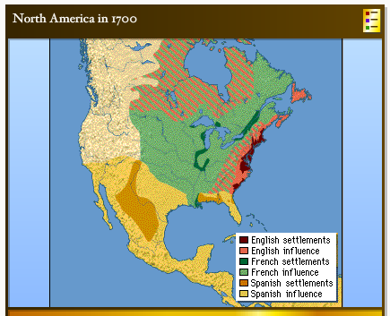

Slide 4
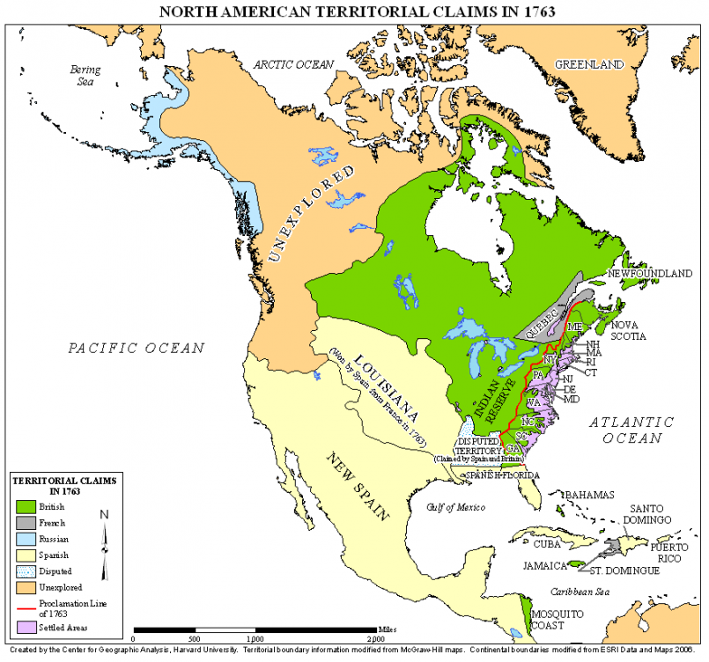
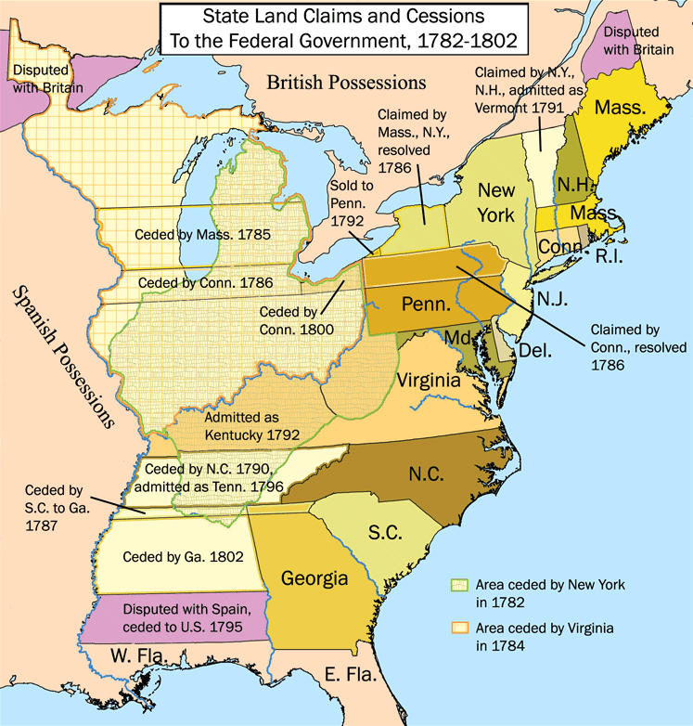

Slide 5
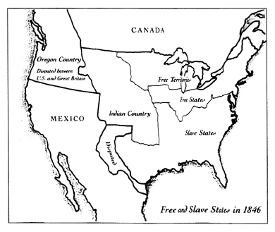

Slide 6
Legislating Citizenship
United States Congress, “An act to establish a uniform Rule of Naturalization” (March 26, 1790).
Be it enacted by the Senate and House of Representatives of the United States of America, in Congress assembled, That any Alien being a free white person, who shall have resided within the limits and under the jurisdiction of the United States for the term of two years, may be admitted to become a citizen thereof.
14th Amendment to the U.S. Constitution: Civil Rights (1868)
Section 1. All persons born or naturalized in the United States, and subject to the jurisdiction thereof, are citizens of the United States and of the State wherein they reside…
Naturalization Act of 1870
Sec. 7. And be it further enacted, That the naturalization laws are hereby extended to aliens of African nativity and to persons of African descent.
Approved, July 14, 1870.

Slide 7
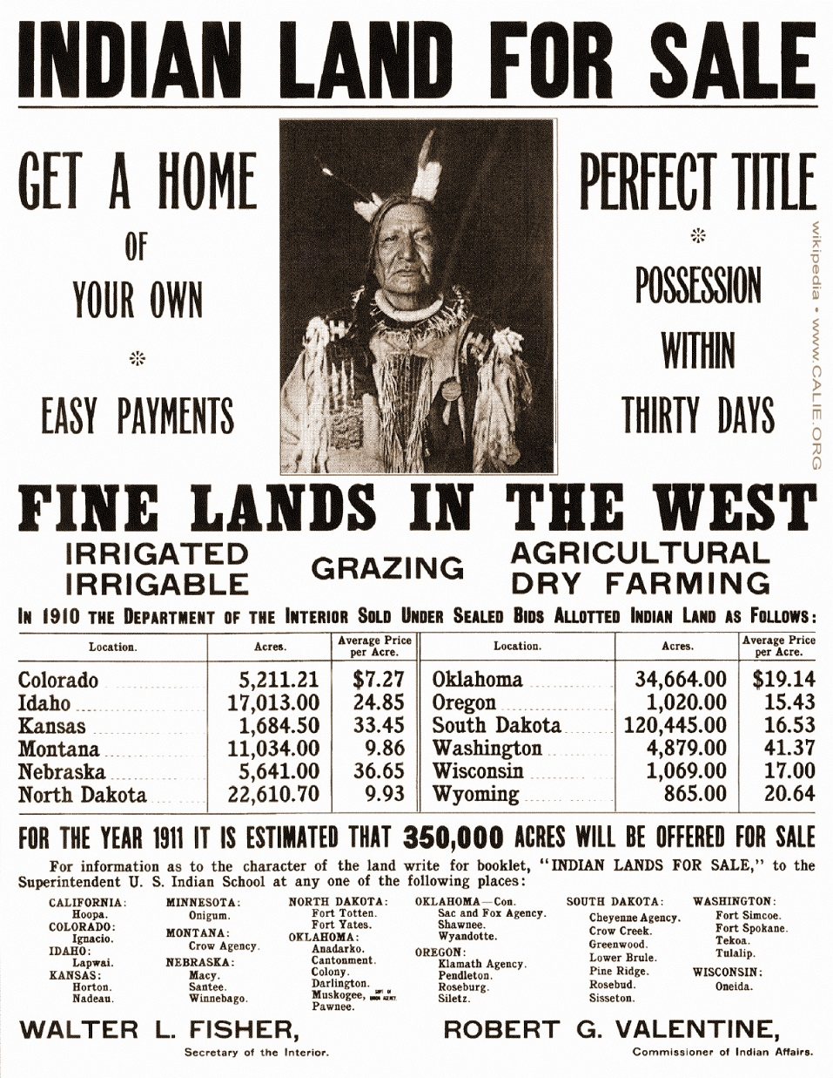

Slide 8
Legislating Immigration
1862 Homestead Act
1882 Chinese Exclusion Act
1887 Dawes Act
1917 “Asiatic Barred Zone”
1924 Immigration Act:
EXCLUSION FROM UNITED STATES. SEC. 13(c) No alien ineligible to citizenship shall be admitted to the United States …
SEC. 28 (c) The term "ineligible to citizenship," when used in reference to any individual, includes an individual who is debarred from becoming a citizen of the United States…
[Basically, European countries got “quotas”; Asia was defined as ¾ of the planet’s territory and “Asians” were all deemed “aliens ineligible to citizenship”; Mexico and the rest of the Americas were not covered by the Act.
That is, Mexicans could continue to cross the border freely, but they could be deported just as feely.]

Slide 9
Inviting and Deporting Mexicans
1848: Take the land, not the people
1917-22: First Bracero Program
1930s: 400,000-1 million Mexicans “repatriated”
1942-64 (67): Second Bracero Program. By late 1950s, 400,000 a year imported and deported
1965: Hart-Celler Act. Cap of 20,000/year turns Mexican migrant workers into deportable “illegal” immigrants

